Slide 1
ECM LATHE
Simon Popecki Carlos Graniello
TURBOCAM International University of New Hampshire

Slide 2
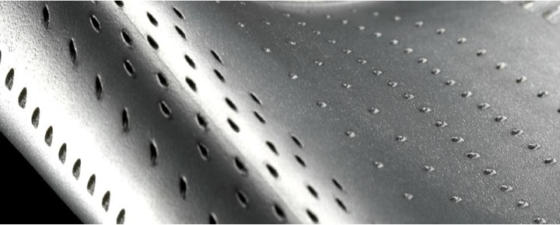
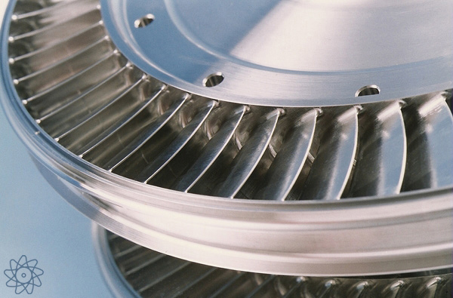
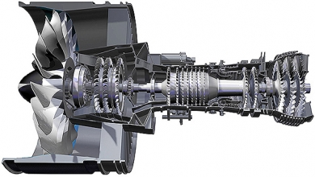

Slide 3
Electrochemical Machining
ECM is reverse electroplating
Machining is underwater (electrolytes)
Non-contact – metal atoms are ionized by applied charge, leave the part
Material hardness is irrelevant
For conductive materials only (including some cermets and semiconductors)
No heat affected areas or distortion to the part – machining force is low
No tool wear
Excellent surface quality – can be used as a finishing process
High dimensional accuracy
Commonly used to manufacture superalloy flow path components

Slide 4
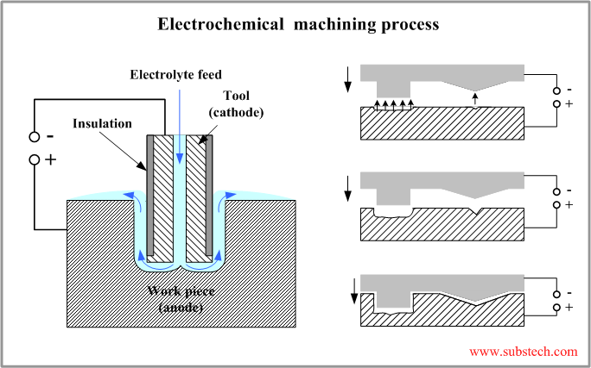

Slide 5
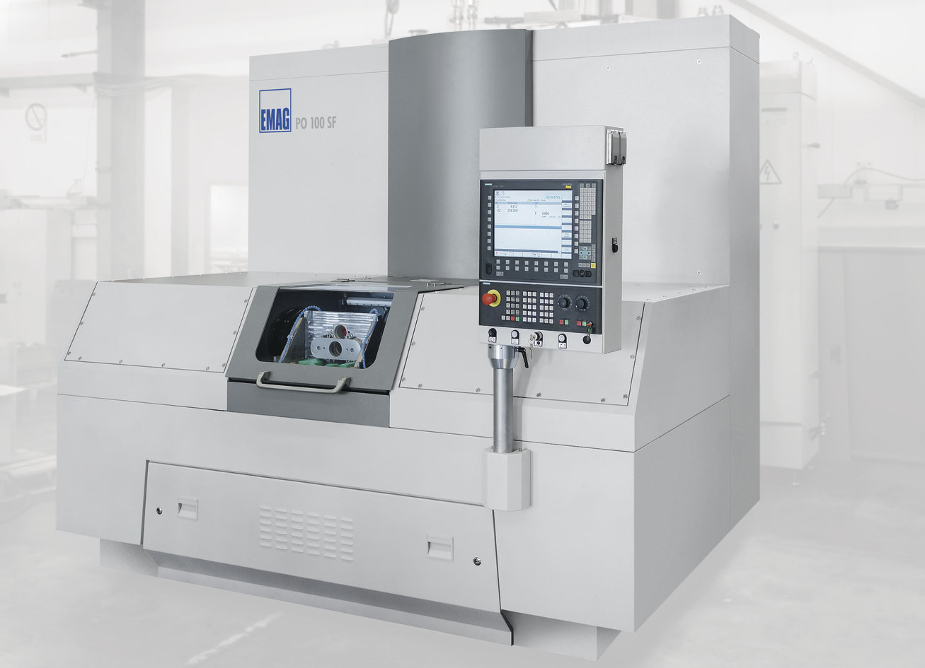
Industry Proven Production Machine:
>$1,000,000

Slide 6

Our Machine
<$12,000

Slide 7
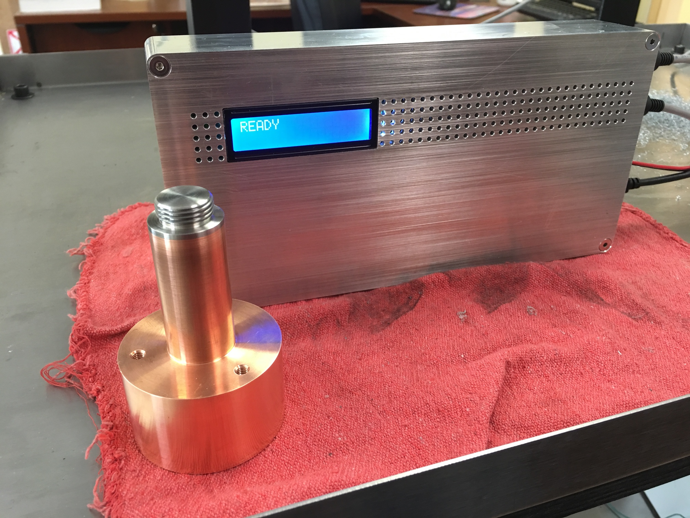
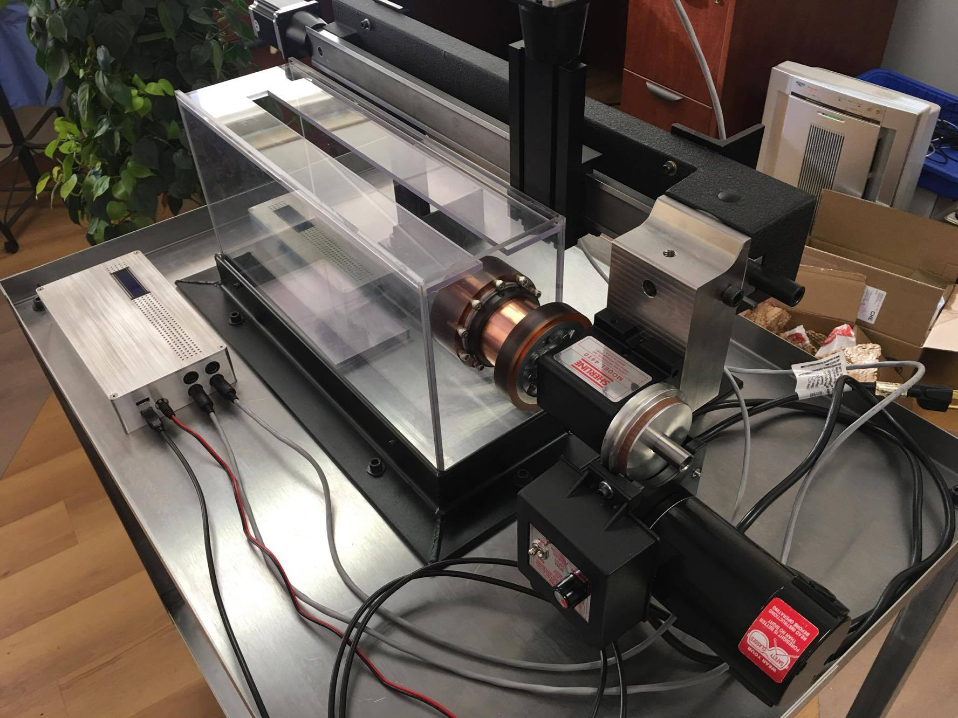

Slide 8
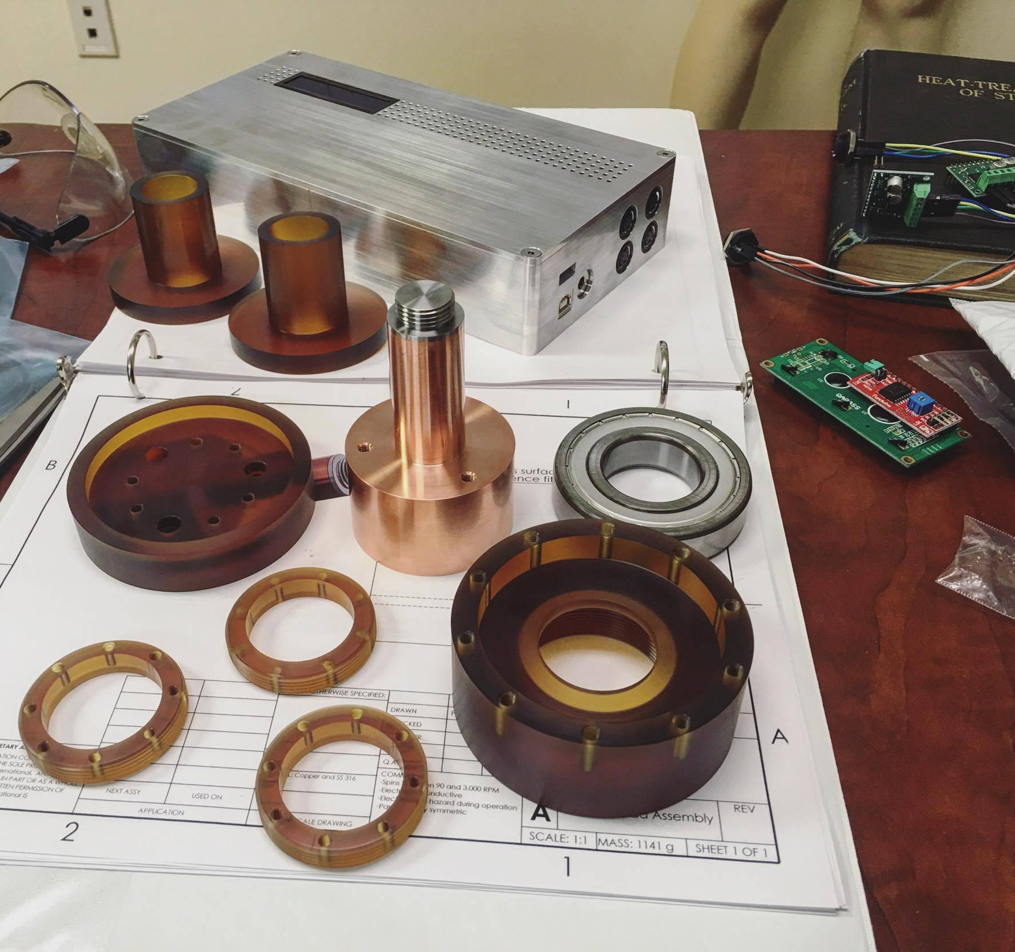
Designing for Manufacturability If your work is good we’ll want to make it
Don’t wanna talk about it
Every cut costs more than you want to spend
Material that’s hard to cut costs even more to cut (AND it’s probably expensive too)
Programming CNC machines costs far more than the materials for ‘one-offs’
Conventional 5-axis = $$$$$$$$$
Something that’s an acronym = $$$$$$$$$
3-axis or turning = $$
3D printing (plastic) = ¥
Tolerances:
.xxxx” = $$$$
.xxx” = $$$
.xx” = $$
.x” = $
$180
$180
$500
$900
$60
$175
$700
$175
$175

Slide 9
What we need help with
Modeling parts we already have
Designing new parts
Safety shield over conductors to protect users from electrocution hazard
Limit switch mounts for positioning system
Improvement of shaft seal design
???

